Slide 1
MARKETING & RETAIL ANALYSIS
MILESTONE 1 - VAIBHAV

Slide 2
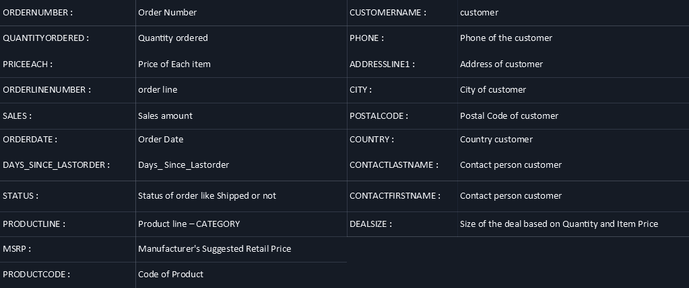
PROBLEM STATEMENT:
An auto-mobile parts manufacturing company has collected data of transactions for 3 years. They do not have any in-house data science team, thus they have hired you as their consultant. Your job is to use your magical data science skills to provide them with suitable insights about their data and their customers.

Slide 3
Summary
The data is about an auto-mobile parts manufacturing company. They have provided the data collected of transactions for 3 years.
The data has 2747 entries (0 To 2746) of rows and 20 columns. The data has 1 datetime64 , 2 float64, 5 int64,and 12 Object data types.
The dataset has both no null values and no duplicate rows of data.
This data more or less reflects the purchasing behavior of customers in different categories . The company is into auto-mobile part manufacture, and they have different product line like Classic car , Motorcycle, plane, train, ship, Bus truck, vintage cars etc.
There is presence of outliers in variables such as Quantity ordered, Price and Sales.
Variable ‘Sales’ has highest positive skewness(0.784) and Variable ‘Days_since_lastorder’ has lowest negative skewness(-0.002).
The data maintained each transactions entry as order number and for each order number maintained all required information like customer identity details , and product details like price , quantity , product code, and sales for each customer.
We have noticed that one order number has many different entries with different product codes.
Manufacturer's Suggested Retail Price(MSRP) for each product code is decided but we found that this is not matching with Price of Each item & is inconsistent with MSRP.

Slide 4
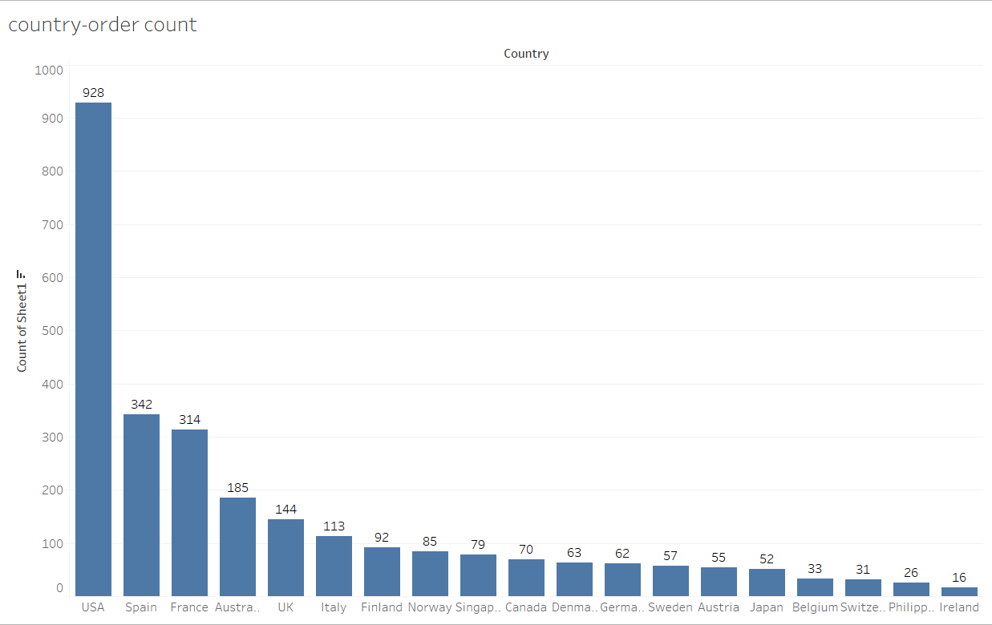
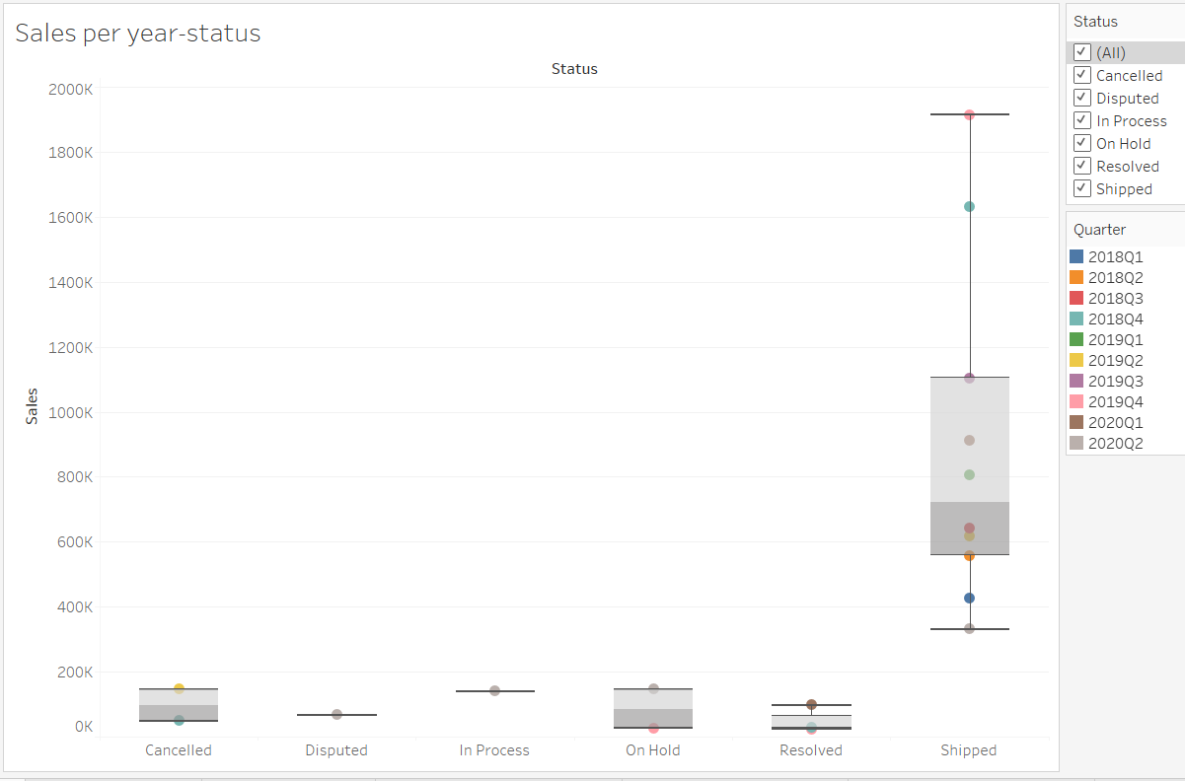
EXPLORATORY DATA ANALYSIS-
Univariate, Bivariate, and multivariate analysis using data visualization

Slide 5
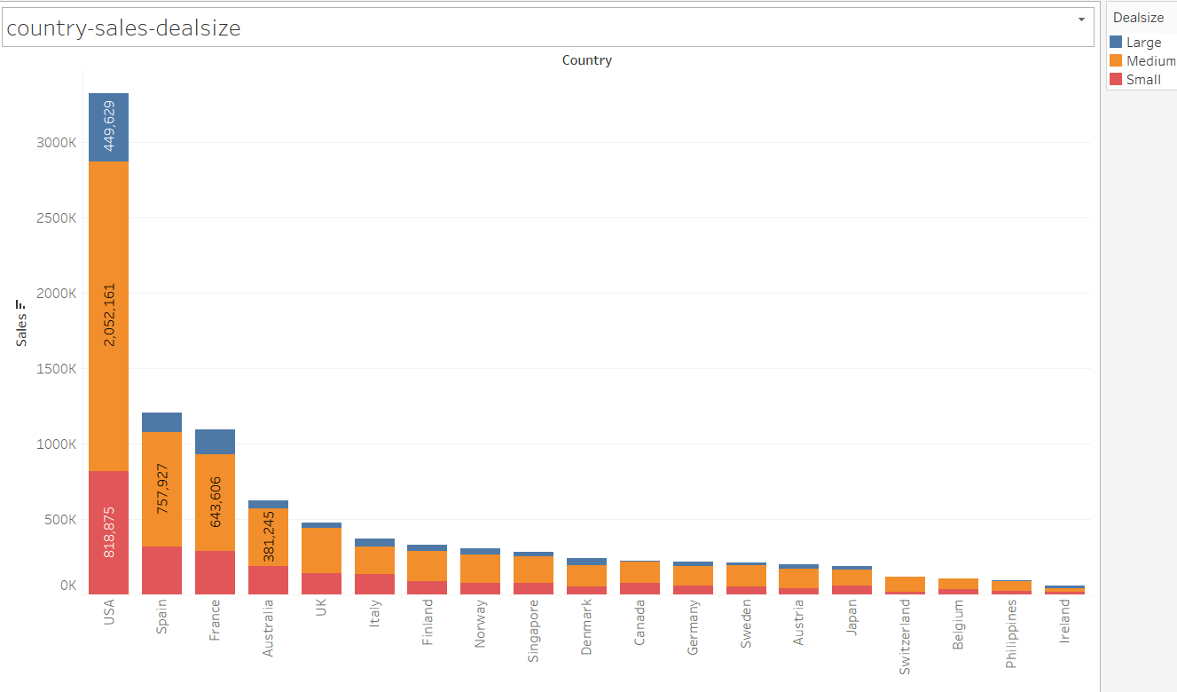
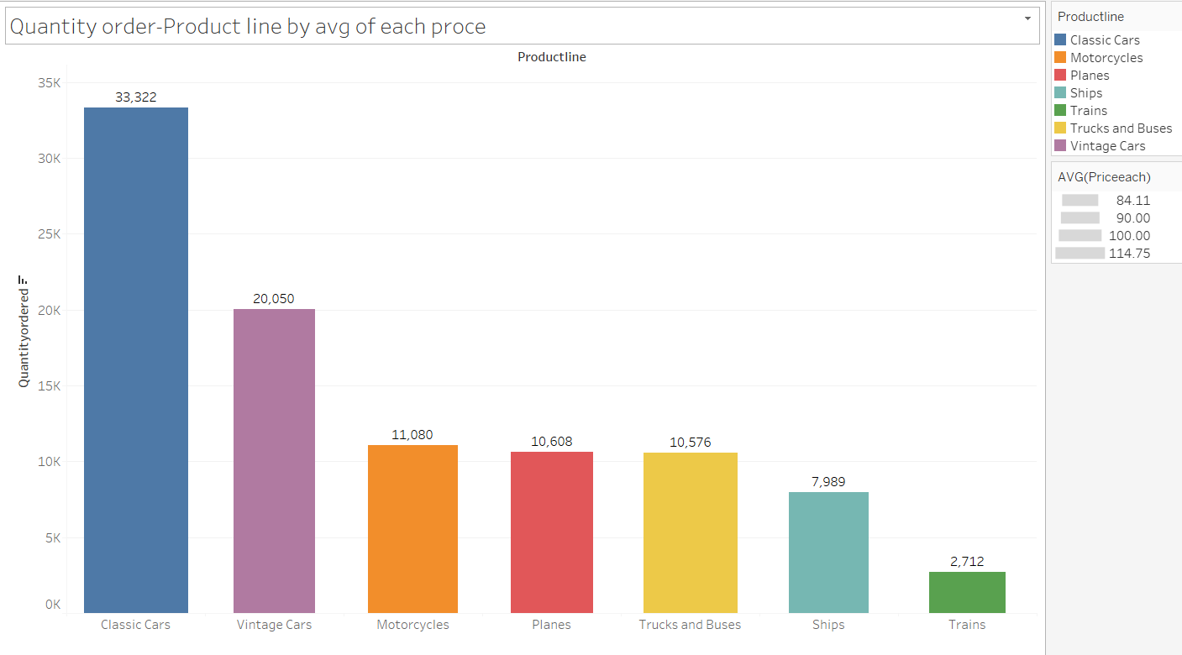
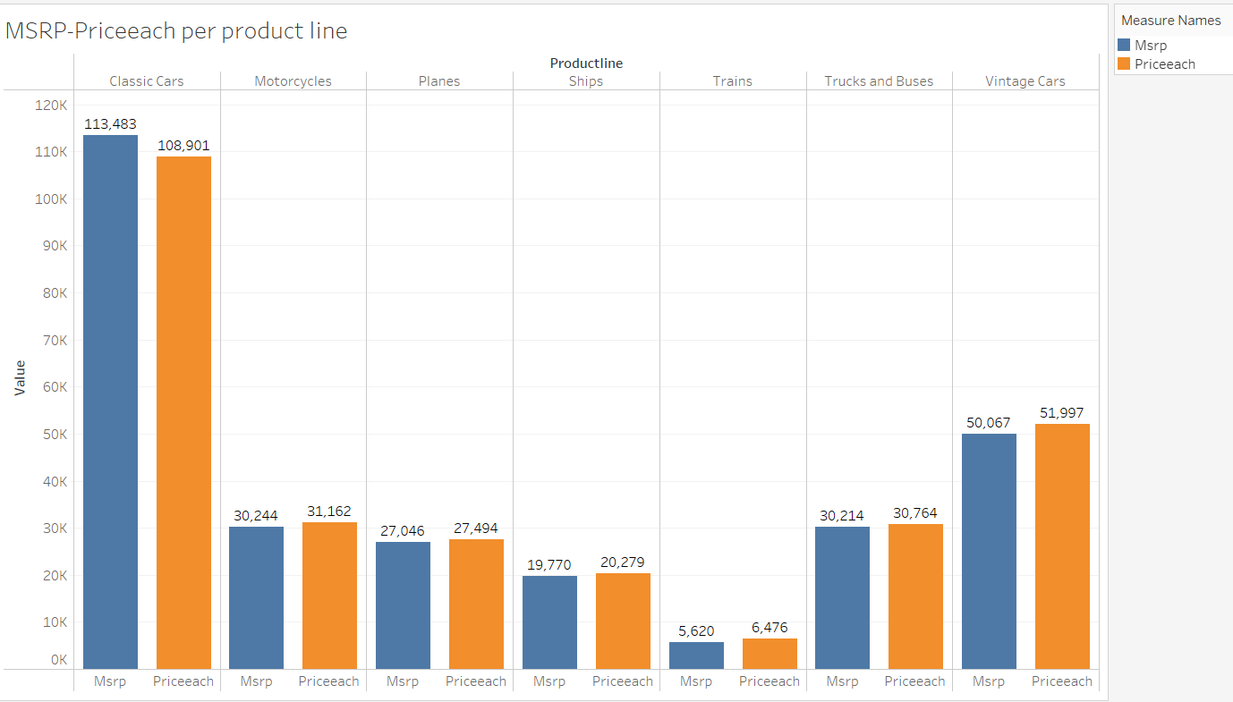
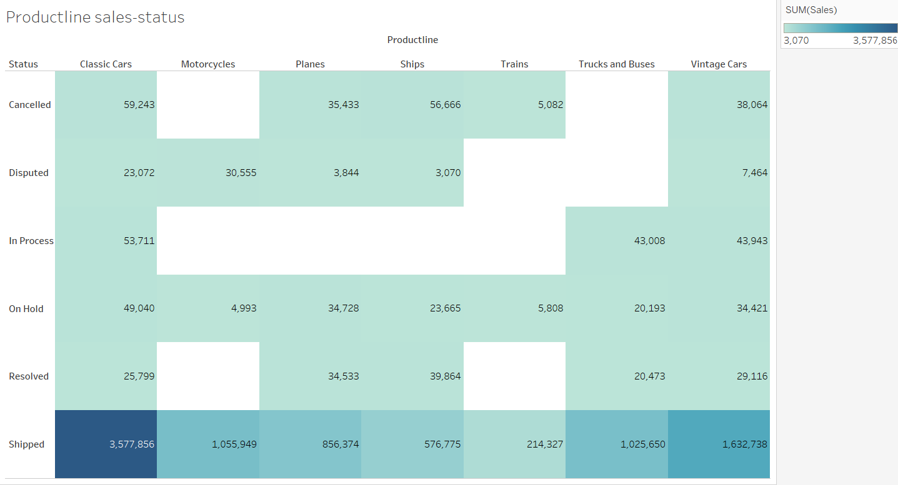
Analysis on Sales, Country, Deal Size, Quantity order, Product line and MSRP
Sales are high for classic cars, the company has even sold below MSRP, there might be a chances that the company has given more discounts to its customers. And vice versa for vintage cars were the company has sold above MSRP.

Slide 6
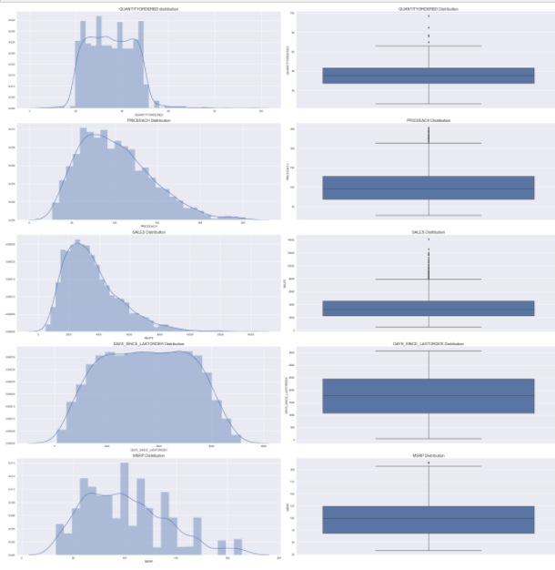
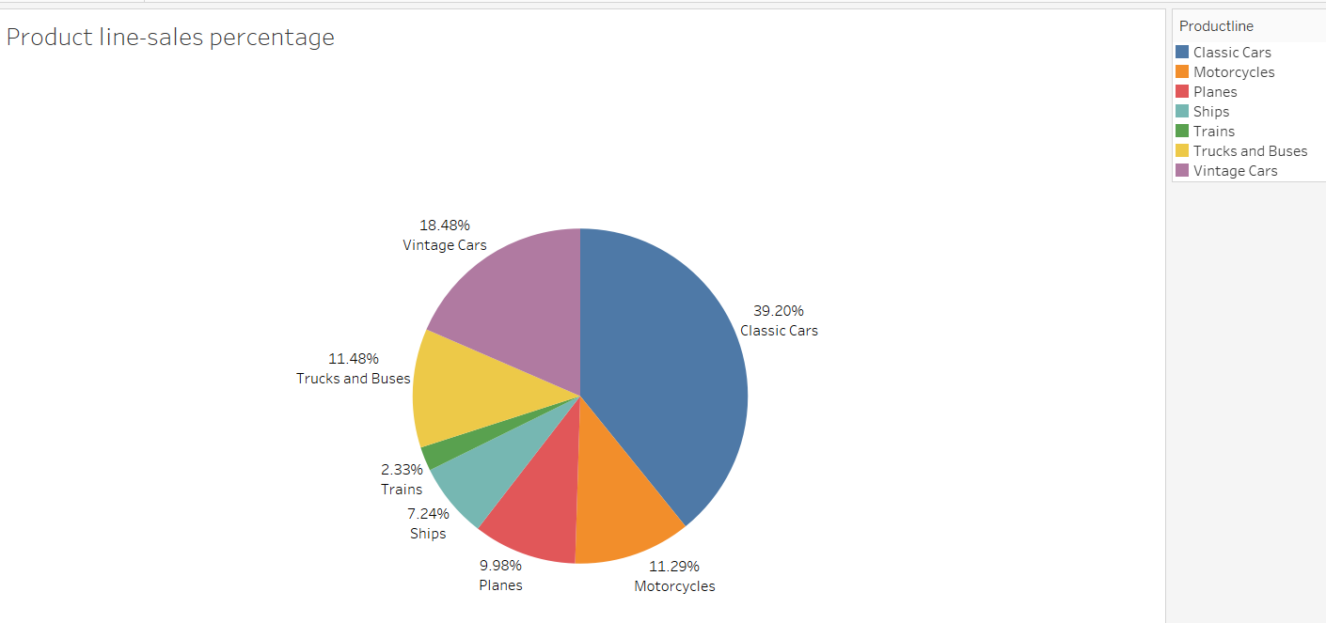
Distplot and Boxplot
There is presence of outliers in variables such as Quantity ordered, Price and Sales.
Variable ‘Sales’ has highest positive skewness(0.784) and Variable ‘Days_since_lastorder’ has lowest negative skewness(-0.002)
Using boxplot on sales & product line variables we have plotted bivariate analysis. We can clearly see that outlier is present in each product line category .Using boxplot on sales & deal size variables we have plotted bivariate analysis. We can clearly see that outlier is present in Large deal size. In Pie chart we can see the larger portion of classic cars followed by vintage cars were as trains has the least demand.

Slide 7
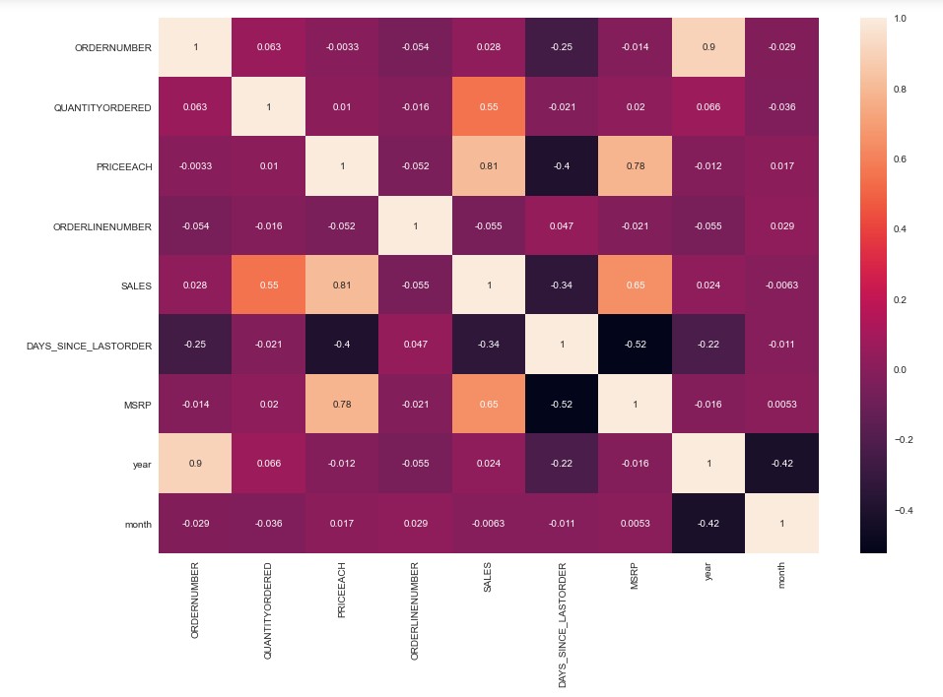
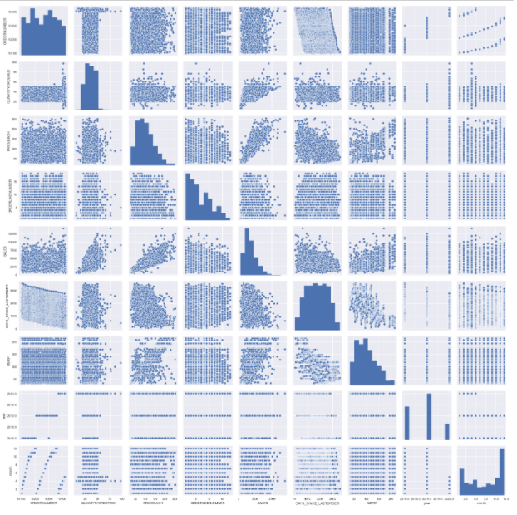
Multivariate Analysis
Variables ‘Sales’ and ‘Price each’ have highest positive Correlation(0.81) and Variables ‘Days_since_lastorder’ and ‘MSRP’ have highest negative Correlation(-0.52)
From the plot , we can see that none of the variables are symmetric.
Variables ‘Sales’ and ‘Price each’ have almost linear relationship between them.
From the plots , we can see there is higher spread of data along the trend line for MSRP compared to Price each. So we need to maximize sales by identifying respective items for which there is higher price change.

Slide 8
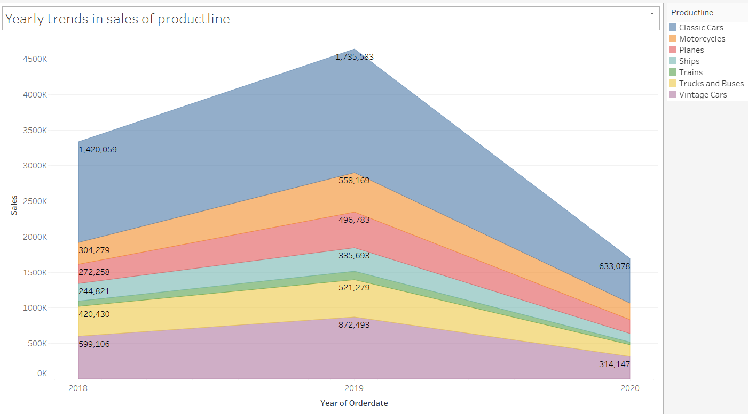
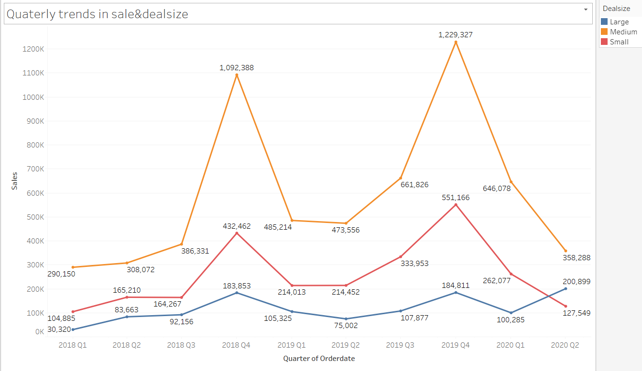
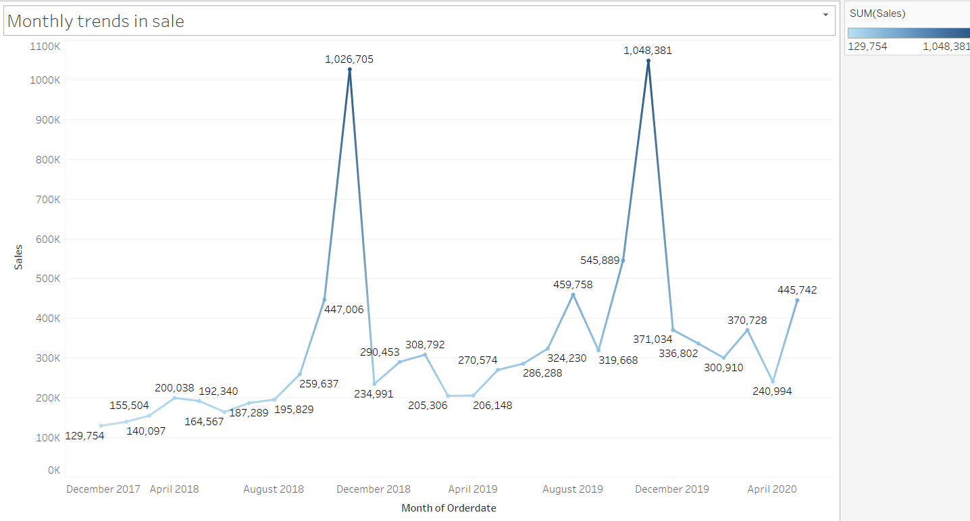
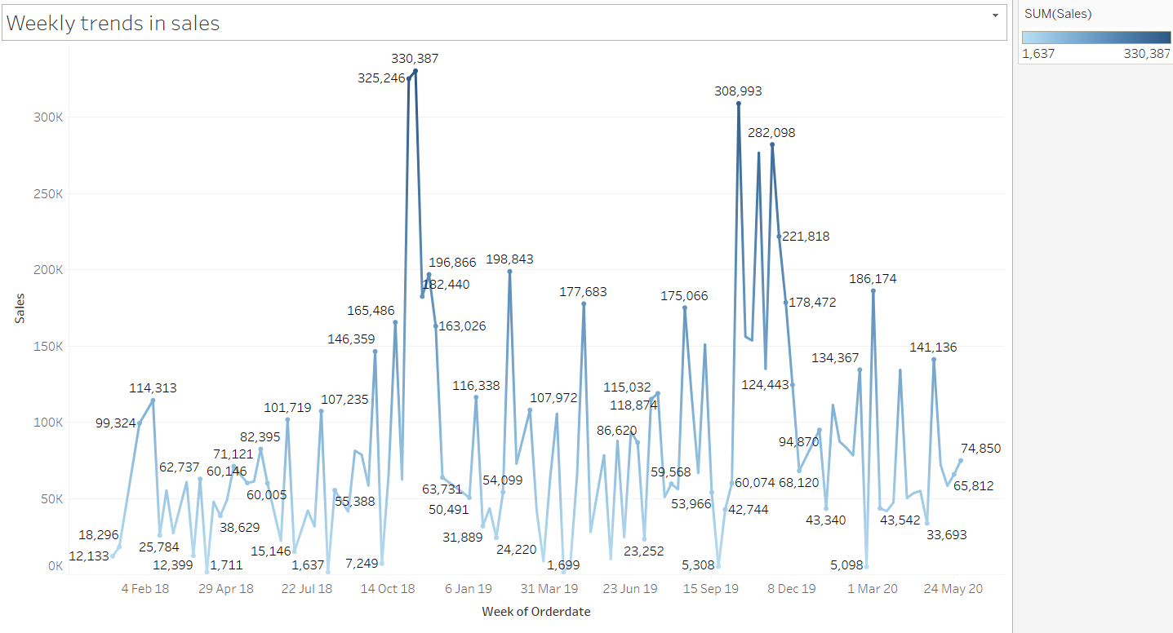
Weekly, Monthly, Quarterly, Yearly Trends in Sales
Yearly, Quarterly, monthly, Weekly time series analysis & its trend are been shown. We observed that in Last quarter sales are high as compared to other quarters. There is a seasonality seen.

Slide 9
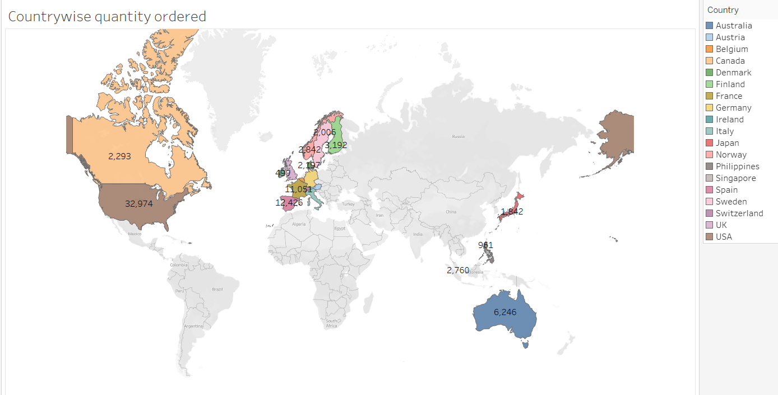
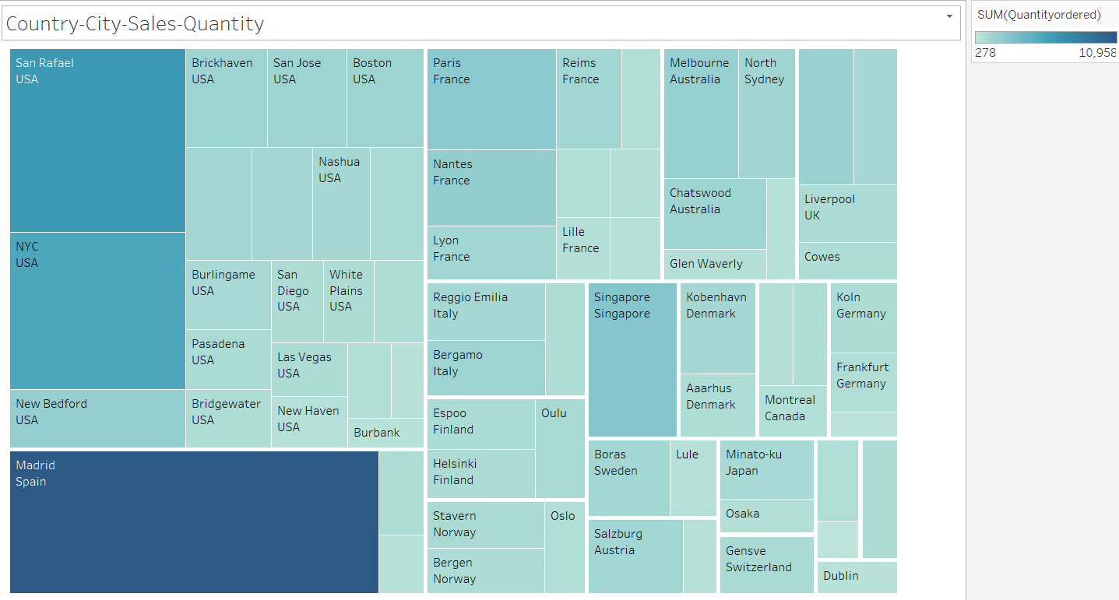
Country Wise Quantity ordered
USA has the highest count of customers(32) and Ireland has the least count of customers(1).

Slide 10
Inferences
Using histogram on sales variable, we did univariate analysis.
For categorical variable like product line we did univariate analysis using bar plot.
Using boxplot on sales, product line, deal size variable we have plotted bivariate analysis.
Using MSRP, Price each, status, sales & product line variables we did multivariate analysis.
After doing the analysis, we can see there is a high demand of classis cars followed by vintage cars and the least is for trains.
The sales are high for the last Quarter of the year.
The demand for classic cars are so high that the company have sold the product below MSRP giving the customers a good discount.
And Vintage were sold above MSRP.

Slide 11
Customer Segmentation using RFM analysis
Customer Segmentation done by using KNIME and MS Excel by dividing the data based on Recency, Frequency and Monetary variables through grouping data by variable ‘Order Number’.
As per the suggestion about ignoring the column "Days Since last order" .
created new column name Recency as "[Max(order date) - order date)]"We have assumed “30-05-2020“ as a reference date and created recency column.
If we can see the data there are same order number repeated for different product Code. So we can assume count of each order number as frequency of an order number.
In SALES column we get sales amount for each transaction. We can use SALES parameter and using an assumption of sum of aggregation we created a new column as Monetary
Then created four different bin for each Recency, frequency & Monetary using percentile range(0,0.10, 0.70,100).Based on above 4 bin assumption we have considered 4 segments like Loyal , Best , Lost and the customers on the verge of Churn.

Slide 12
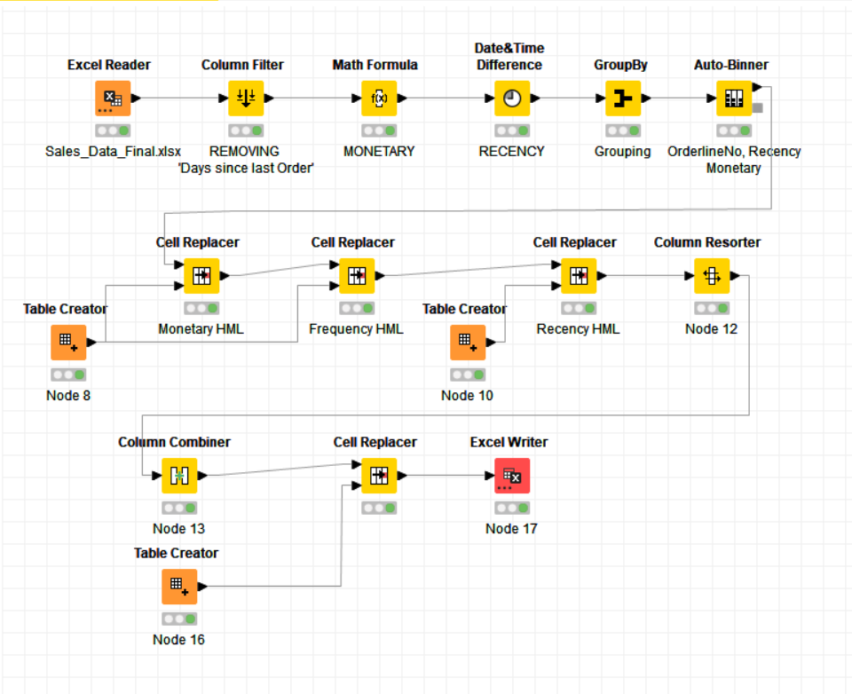
KNIME Work and Output table Image ->

Slide 13
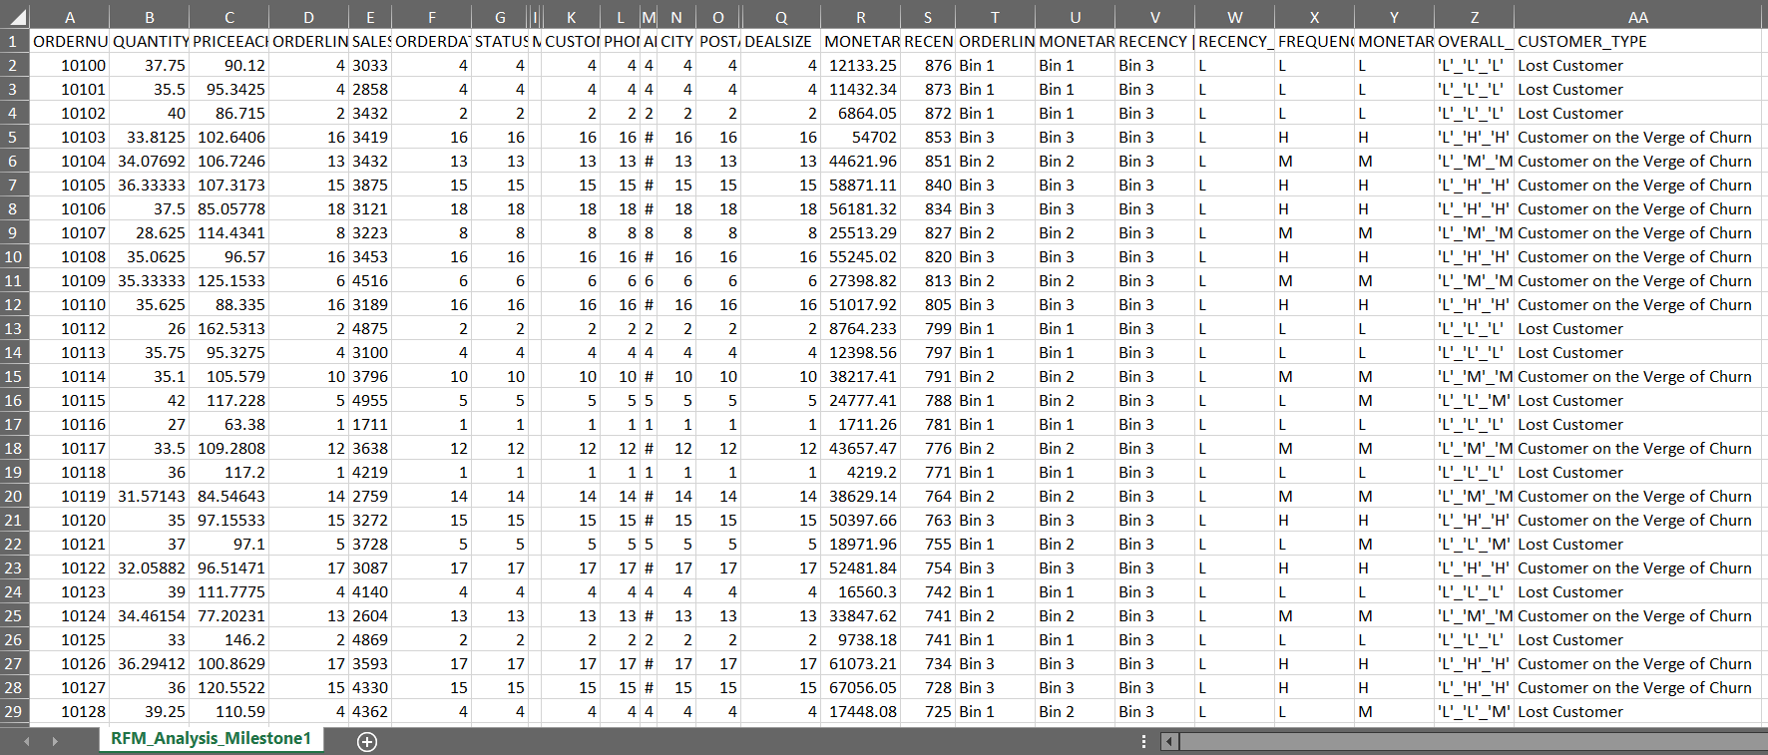
KNIME WORKFLOW and Output table Image-

Slide 14
Inferences from RFM Analysis and identified segments
On basis on Recency, frequency & monetary we have grouped our top customers.
We have given the most significance to recency parameter as these customers has recently purchased our products.
Also according to RFM model the most important is given to recency. Hence we have kept it as our first parameter for selecting top customers for e.g. Customer number -10181,10182, 10185
We should not loose these customers at any cost as they are the biggest contributors of the business.

Slide 15
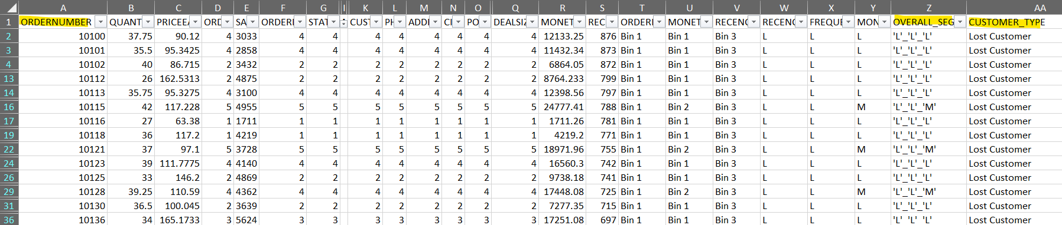
On basis on Recency, frequency & monetary parameters we have grouped our Customers who we’d lost
Their recency is very low and hasn’t made any purchase since long. So we can say these are our lost customers. If taken feedback from them and fulfil their demand we might bring them back to been a good customer.
But suggestion is to not to invest much time on these type of customers.
As these are the most avoidable customers as they are with lowest level in all aspects Recency, Frequency and Monetary. There is no point in spending time and effort to maintain business with these customers.

Slide 16
Jupyter Notebook-
Vaibhav_MRA _Project1.ipynb
Tableau Workbook-
Vaibhav_MRA _Project1-
https://public.tableau.com/views/MRAProject-Milestone1_16326817785040/country-ordercount?:language=en-US&publish=yes&:display_count=n&:origin=viz_share_link

